Slide 1

Homily Preparation Webinar
(Arch-) Dioceses of the
Provinces of California
Tuesday, August 31: Preparing for
23rd Sunday Ord. Time, Sept. 5, 2021
Fr. Felix Just, S.J., Ph.D.
http://catholic-resources.org

Slide 2
Welcome! Thanks! Blessings!
Structure of Today’s Presentation:
  Contemporary Context
  Overview of This Sunday’s Readings
  Gospels for Year B, esp. 23rd Sunday
  Other Readings for 23rd Sunday, Year B
  Ideas for your homilies
  Questions & Discussion
Lectionary for Mass Website:
  http://catholic-resources.org/Lectionary

Slide 3
Weekly Prep: “Mark-up Method”
Use texts that you can write on:
  Go to USCCB website & print out readings
    http://usccb.org/bible/readings/
  Or use a Missalette:
    Give Us This Day, or Magnificat, or Living with Christ
  Or photocopy pages from a printed Lectionary
    So you can underline or make your own notes
For each reading, highlight or circle or underline any key words that JUMP OUT at you!

Slide 4

Current Contexts:
Ecclesial:
  “Ordinary Time” – (Fall: Luke on Weekdays)
  LA Archdiocese: 250th Jubilee (Sept. 8, 11, etc.)
  “Year of St. Joseph” & “Year of Amoris Laetitia Family”
Social / Cultural:
  Labor Day Weekend; Schools Beginning
  CA Recall Election (Sept. 14)
  COVID ongoing; Divisions over Masks & Vaccines
  Fires! Hurricanes! Haiti, Afghanistan, Lebanon, etc.
Local Issues:
  Your parish, community, region?

Slide 5
23rd Sunday in Ordinary Time, Year B
1st Reading: Isaiah 35:4-7a
  “The ears of those who are deaf will be cleared;
  and the tongue of those who are mute will sing.”
Resp. Psalm 146:6-7, 8-9, 9-10
  “Praise the Lord, my soul!”
2nd Reading: James 2:1-5
  “Did not God choose the poor to be heirs of the kingdom?”
Alleluia (cf. Matt 4:23)
  “Jesus proclaimed the Gospel of the kingdom and cured every disease among the people.”
Gospel: Mark 7:31-37
  “He makes the deaf hear and the mute speak.”

Slide 6
Overview: Sunday Gospels, Year B
17th – 21st Sun. – John 6, Bread of Life Discourse
22nd Sun. (Aug. 29) – Mark 7:1-8, 14-15, 21-23
Purity traditions vs. God’s core commandments
23rd Sun. (Sept. 5) – Mark 7:31-37
Healing of a deaf-mute
24th Sun. (Sept. 12) – Mark 8:27-35
Peter’s Confession & First Passion Prediction
25th Sun. (Sept. 19) – Mark 9:30-37
Second Passion Prediction & Cost of Discipleship
26th Sun. (Sept. 26) – Mark 9:38-43, 45, 47-48
More teachings about faithful discipleship

Slide 7
Mark 7–8 on Weekdays: Weeks 5-6
Mark 7:1-13 Week 5, Tues
Mark 7:14-23 Week 5, Wed
Mark 7:24-30 Week 5, Thurs
Mark 7:31-37 Week 5, Fri
Mark 8:1-10 Week 5, Sat
Mark 8:11-13 Week 6, Mon
Mark 8:14-21 Week 6, Tues
Mark 8:22-26 Week 6, Wed
Mark 8:27-33 Week 6, Thurs
Mark 8:34–9:1 Week 6, Fri

Slide 8
Mark 7 – 8
Jesus argues w/ Pharisees about purity laws & ritual traditions (7:1-23)
Jesus exorcizes the Syrophoenician woman's daughter (7:24-30)
Jesus enables a deaf-mute person to hear and speak (7:31-37)
Jesus Feeds 4000 People in Gentile territory
with seven loaves and a few fish (8:1-10)
The Pharisees ask for a sign from Jesus (8:11-12)
Jesus and his disciples depart in a boat (8:13-14)
Jesus' disciples fail to understand about the yeast and bread (8:15-21)
Two-Stage Restoration of Sight to a Blind Person at Bethsaida,
northeast of the Sea of Galilee (8:22-26)
Confession of Peter & Teachings on Discipleship (8:27ff)

Slide 9
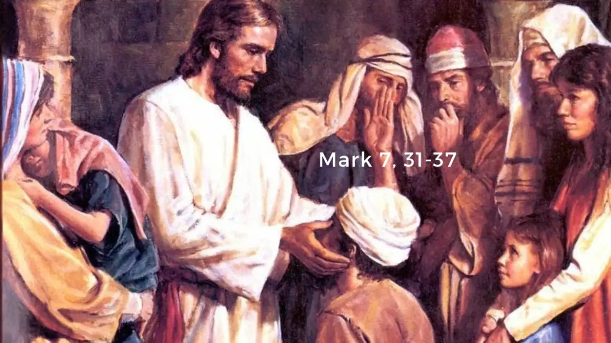

Slide 10
23rd Sun, Yr. B – Mark 7:31-37
Again Jesus left the district of Tyre and went by way of Sidon
to the Sea of Galilee, into the district of the Decapolis.
And people brought to him a deaf man who had a speech impediment
and begged him to lay his hand on him.
He took him off by himself away from the crowd.
He put his finger into the man’s ears and, spitting, touched his tongue;
then he looked up to heaven and groaned, and said to him,
“Ephphatha!”— that is, “Be opened!” —
And immediately the man’s ears were opened,
his speech impediment was removed, and he spoke plainly.
He ordered them not to tell anyone.
But the more he ordered them not to, the more they proclaimed it.
They were exceedingly astonished and they said,
“He has done all things well. He makes the deaf hear and the mute speak.”

Slide 11
Mark 7:31-37 – Healing a Deaf-Mute
Gentile Territory
  Tyre, Sidon, Decapolis
Use of Spittle
  Only here and Mark 8:22-26 (blind man)
  Stories dropped by both Matt & Luke
Deaf & Mute: Caution!
  Actual People vs. Metaphorical (everyone!)

Slide 12
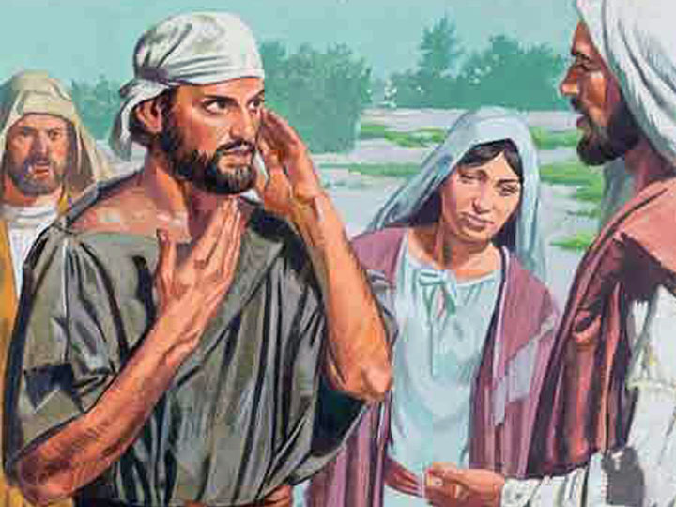
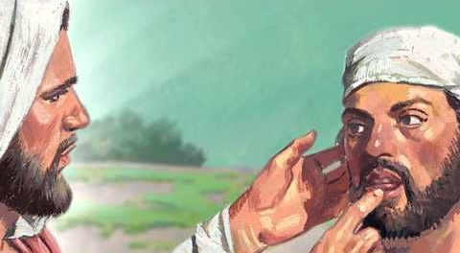
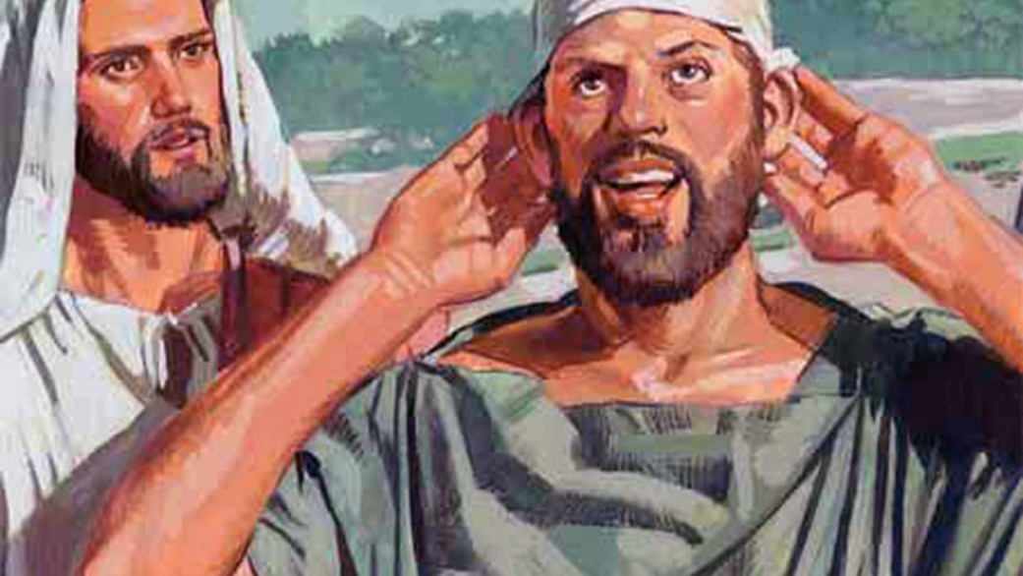

Slide 13
23rd Sun., Year B – Isaiah 35:4-7a
Thus says the LORD:
Say to those whose hearts are frightened:
Be strong, fear not!
Here is your God,
he comes with vindication;
with divine recompense
he comes to save you.
Then will the eyes of the blind be opened,
the ears of the deaf be cleared;
then will the lame leap like a stag,
then the tongue of the mute will sing.
Streams will burst forth in the desert,
and rivers in the steppe.
The burning sands will become pools,
and the thirsty ground, springs of water.

Slide 14

Isaiah 35:4-7a
“Messianic” Reading, also used in Advent:
Isa 35:1-6a, 10 – 3rd Sunday, Year A
Isa 35:1-10 – Monday, 2nd Week
Themes of restoration, wholeness, peace!

Slide 15
23rd Sun – Psalm 146:6-7, 8-9, 9-10
R. Praise the Lord, my soul! or: R. Alleluia.
The God of Jacob keeps faith forever,
secures justice for the oppressed,
gives food to the hungry.
The LORD sets captives free.
The LORD gives sight to the blind;
the LORD raises up those who were bowed down.
The LORD loves the just;
the LORD protects strangers.
The fatherless and the widow the LORD sustains,
but the way of the wicked he thwarts.
The LORD shall reign forever;
your God, O Zion, through all generations. Alleluia.

Slide 16
Overview: 2nd Readings, Year B
29: 22nd Sun. – Jas 1:17-18, 21b-22, 27
“Be doers of the word (and not hearers only)”
9/5: 23rd Sun. – Jas 2:1-5
“Did not God choose the poor to be heirs of the kingdom?”
9/12: 24th Sun. – Jas 2:14-18
“Faith, if it does not have works, is dead”
9/19: 25th Sun. – Jas 3:16—4:3
“The fruit of righteousness is sown in peace…”
9/26: 26th Sun. – Jas 5:1-6
“Your wealth has rotted away”

Slide 17
23rd Sun, Year B – James 2:1-5
My brothers and sisters, show no partiality
as you adhere to the faith in our glorious Lord Jesus Christ.
For if a man with gold rings and fine clothes comes into your assembly,
and a poor person in shabby clothes also comes in,
and you pay attention to the one wearing the fine clothes
and say, “Sit here, please, ”
while you say to the poor one, “Stand there, ” or “Sit at my feet, ”
have you not made distinctions among yourselves
and become judges with evil designs?
Listen, my beloved brothers and sisters.
Did not God choose those who are poor in the world
to be rich in faith and heirs of the kingdom
that he promised to those who love him?
[Connections with “Labor Day” theme?]

Slide 18
Reflecting on these Readings:
WHAT is going on here? – Content?
  Those who don’t hear: Jesus says “Ephphatha!”
  Those who can’t speak: Jesus removes impediments
SO WHAT? – Message/Relevance for Us?
  Do we even want to listen to Jesus (discipleship)?
  Are we able to speak about Jesus (evangelize)?
NOW WHAT? – Application in Action?
  How can Jesus help us, heal us, restore us, free us?
  Labor Day: How do we treat the “rich” and “poor”?
  LA Jubilee Year: “Forward in Mission”
    https://forwardinmission.com/

Slide 19
Your Homily This Sunday?
What Is Your ONE OVERALL THEME?
  CONTENT? What message do you want to convey?
  RELEVANCE? How will this “grab” your hearers?
  FOCUS? What will be your brief “sermon title”?
What Are Your THREE MAIN POINTS?
  Three aspects of your theme to explore/illustrate?
  Past, Present, Future? or Individual, Local, World?
  Any Images or Illustrations?

Slide 20
Conclusion
Overview of Ordinary Time, Year B:
  http://catholic-resources.org/Lectionary/1998USL-OrdinaryB.htm
More on Biblical Texts:
  http://catholic-resources.org/Bible/
Thanks for participating today!
  Reactions? Questions? Discussion?
  Please “RAISE YOUR HANDS” (electronically)
  OR Type in a Comment/Question

